Slide 1

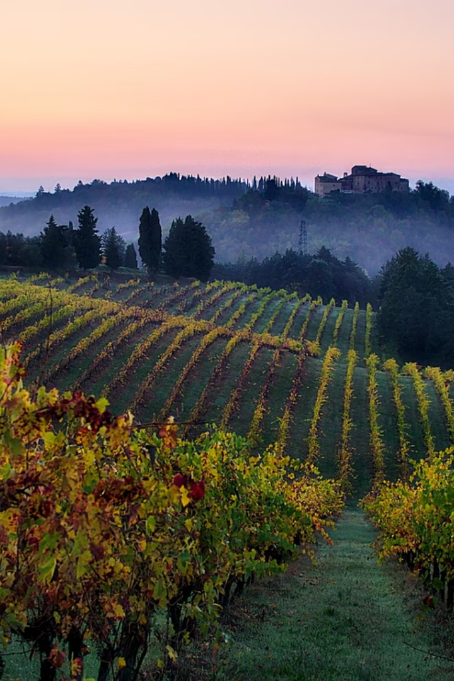
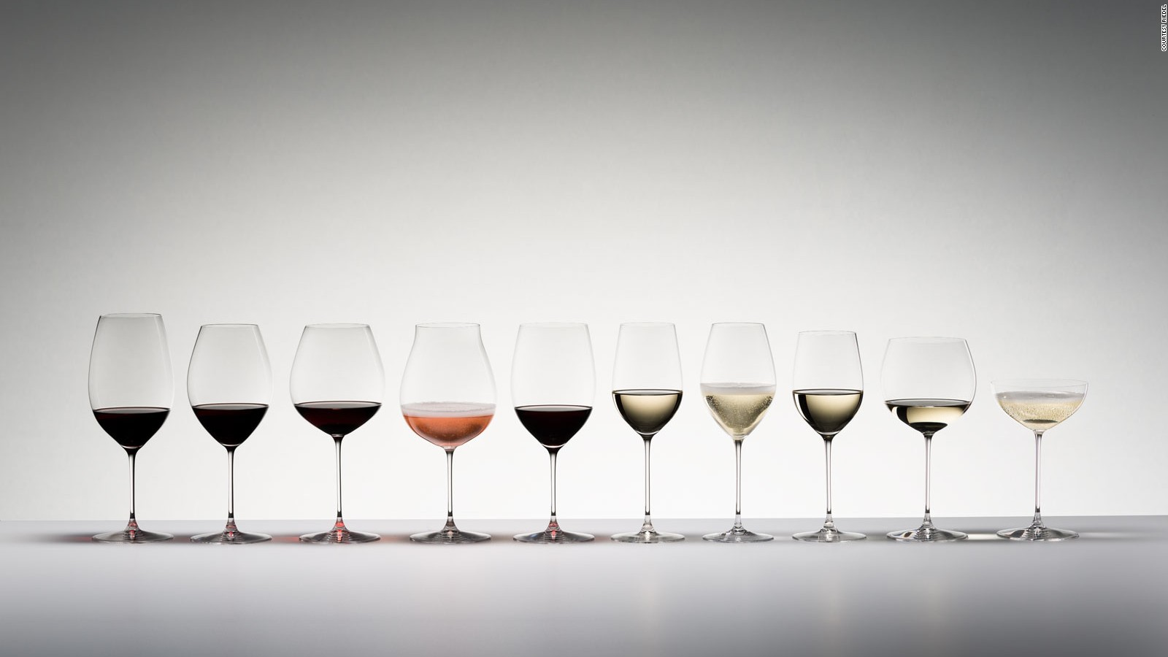
Wine Quality Dataset
The wine quality dataset is a rich collection of attributes and quality ratings for various types of wine. It encompasses a wide range of features that can be used to predict and analyze the quality of different wines. This dataset provides a valuable opportunity for applying artificial intelligence and machine learning techniques to gain insights into the factors influencing wine quality.

Slide 2

Team Details
Pushpinder Singh - 2210990693
Pratham Khanna - 2210990673

Slide 3

Overview of Artificial Intelligence and Machine Learning
1
AI Advancements
Artificial intelligence has made significant progress in recent years, enabling machines to perform tasks that typically require human intelligence.
2
Machine Learning Techniques
Machine learning algorithms allow systems to learn from data, identify patterns, and make decisions without explicit programming.
3
Application in Various Sectors
AI and machine learning are widely used in healthcare, finance, transportation, and many other industries.

Slide 4

Importance of Wine Quality Prediction
1
Quality Assessment
2
Consumer Preference
Predicting wine quality helps in assessing the attributes that make a wine desirable, enabling producers to optimize their processes.
Understanding the factors influencing wine quality assists in meeting consumer expectations and preferences.
3
Industry Innovation
Accurate quality prediction drives innovation and improvements in the wine production and distribution industry.

Slide 5
Data Collection and Preprocessing
Data Sourcing
Normalization
Outlier Detection
Collecting relevant wine attributes and quality ratings from various sources such as wineries and industry databases.
Preprocessing the data to ensure consistency and comparability across the different attributes and quality ratings.
Identifying and handling outliers to ensure the integrity of the dataset and the accuracy of predictions.

Slide 6
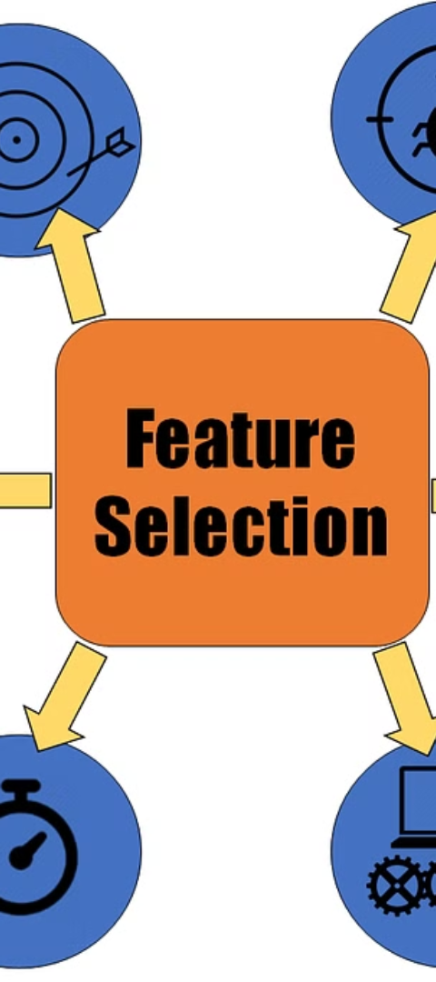
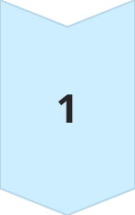
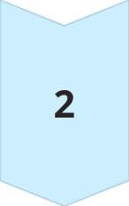
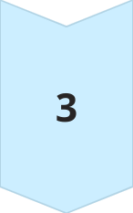
Feature Selection and Engineering
Relevant Attributes
Identifying the wine characteristics that significantly impact quality through feature selection techniques.
New Feature Generation
Creating new attributes that may provide deeper insights into the wine quality through engineering processes.
Data Transformation
Converting attributes into suitable formats and scales to ensure compatibility with machine learning algorithms.

Slide 7
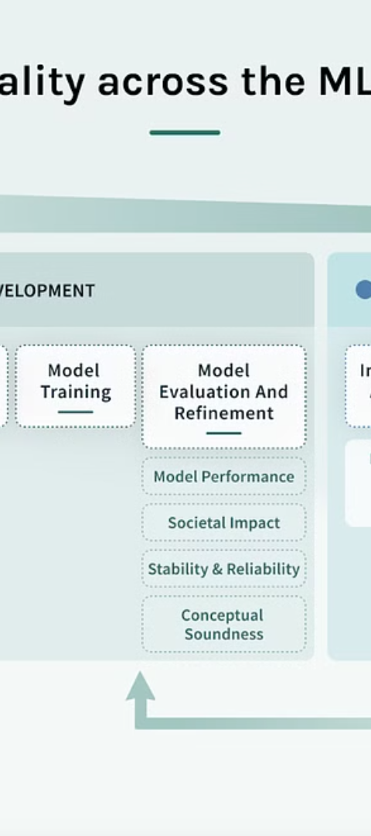
Model Selection and Evaluation
Algorithm Comparison
Validation Techniques
Evaluating various machine learning algorithms to identify the most suitable models for wine quality prediction.
Using cross-validation and other validation strategies to assess and compare model performance accurately.
Hyperparameter Tuning
Optimizing the model parameters to achieve the best possible wine quality predictions.

Slide 8
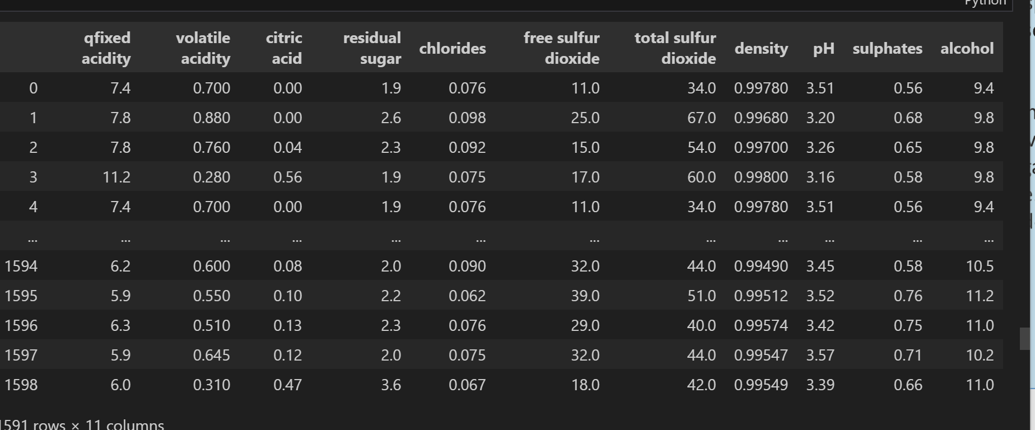
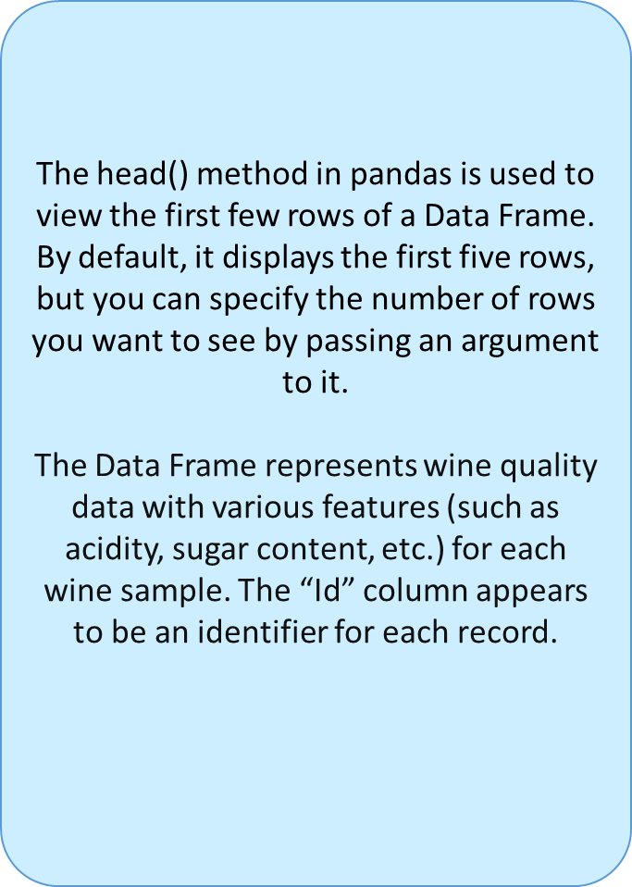

Slide 9
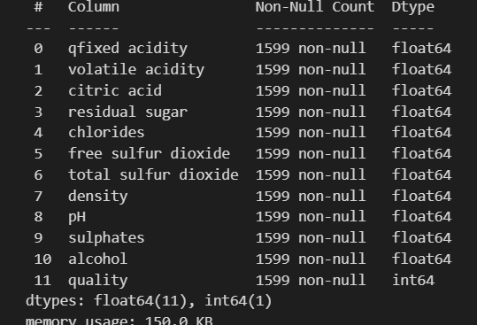
Range Index: Indicates that the Data Frame has a default index range from 0 to 1599u.
Data columns: Lists all the columns in the Data Frame and their properties.
Non-Null Count: Indicates the number of non-null (non-missing) values in each column.
D-type: Specifies the data type of each column. In this Data Frame, there are columns of type float64 (floating-point numbers) and int64 (integer numbers).
Memory usage: Indicates the amount of memory used by the Data Frame to store its data.

Slide 10
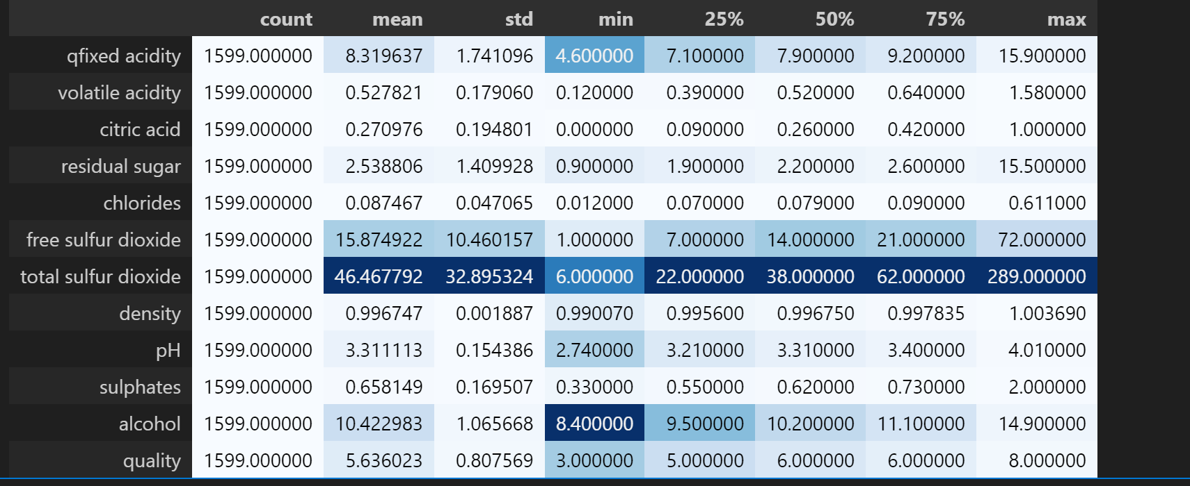
Count: The count of non-null values in each column of the Data Frame.
Mean: The average of each column.
Standard Deviation (std): The measure of the dispersion of values in each column.
Minimum (min): The minimum value in each column.
25th Percentile (25%): Also known as the first quartile, this value indicates the point at which 25% of the data fall below.
50th Percentile (50%): Also known as the median, this value indicates the point at which 50% of the data fall below.
75th Percentile (75%): Also known as the third quartile, this value indicates the point at which 75% of the data fall below.
Maximum (max): The maximum value in each column.

Slide 11
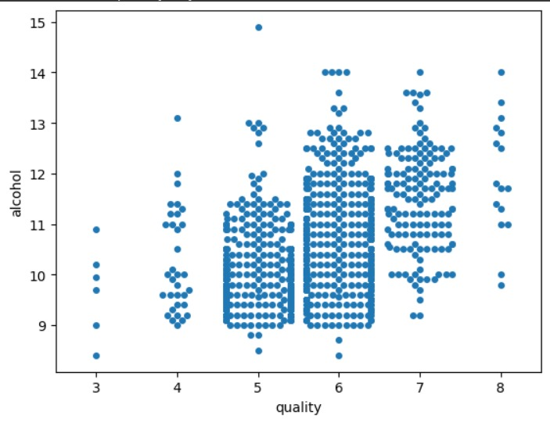
x: This parameter specifies the column in your Data Frame (df) that will be used for the x-axis values. In this case, it's "quality", suggesting that the plot will categorize the data points based on the quality of something.
y: This parameter specifies the column in your Data Frame (df) that will be used for the y-axis values. Here, it's "alcohol", indicating that the plot will display the alcohol content associated with each quality level.
data: This parameter specifies the Data Frame (df) from which the data will be drawn.

Slide 12
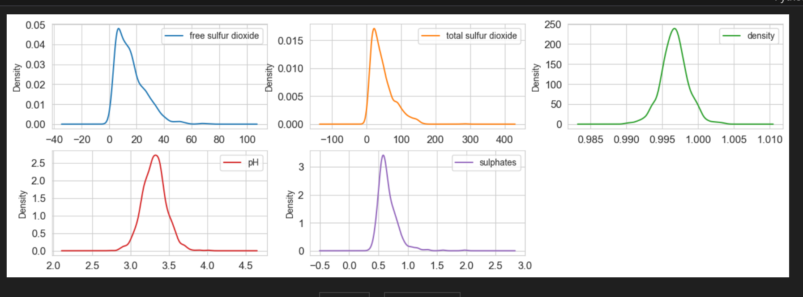
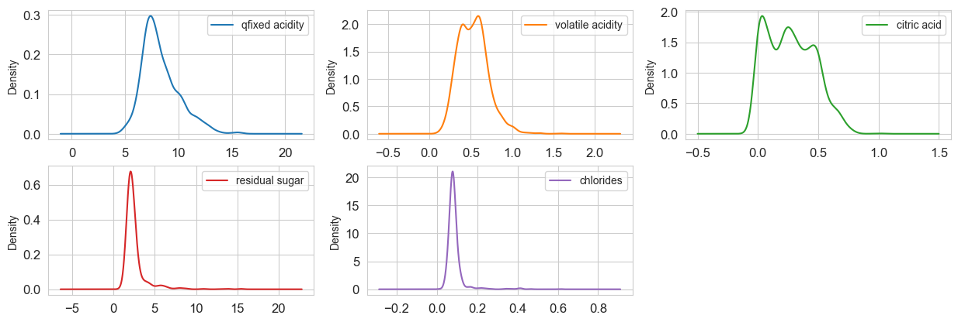
qfixed Acidity: Most wines have an acidity level around 7 to 8.
Volatile Acidity: The distribution is skewed towards lower values.
Citric Acid: Many wines have a small amount of citric acid.
Residual Sugar: The majority of wines have low residual sugar content.
Chlorides: Most wines have low chloride levels.
Free Sulfur Dioxide and Total Sulfur Dioxide: The distributions vary.
Density: Concentrated around a specific range.
pH Level: Centered around 3.2 to 3.5.
Sulphates: Some variation, but generally moderate.
Alcohol Content: Wines span a range of alcohol percentages.
Quality Rating: Distinct bars at ratings like 5 and 6 indicate common quality ratings.

Slide 13
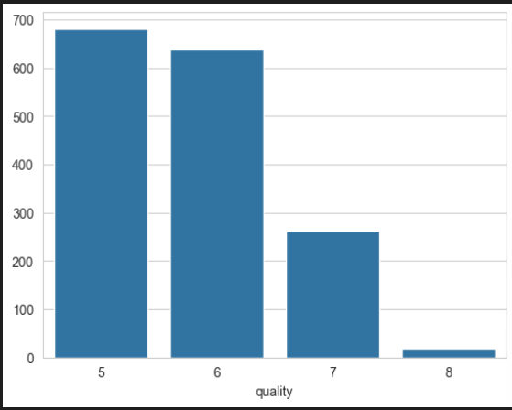
The image shows blue bars, each representing a quality rating.
The x-axis (quality) has values ranging from 5 to 8.
The y-axis (alcohol) has values ranging from 0 to 700.
Observations:
Quality rating 5 corresponds to around 680 units of alcohol.
Quality rating 6 corresponds to around 650 units.
Ratings 7 is less than 350 units.
Ratings 8 have exactly or nearly 10 units of alcohol.
This visualization helps us understand how alcohol content varies across different wine quality ratings.

Slide 14
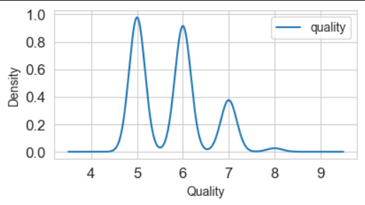
The graph you see is a combination of a histogram and a kernel density estimate (KDE) plot.
It visualizes the distribution of the ‘quality’ values in the wine dataset.
Here’s what each component represents:
The bars represent the frequency (count) of each quality rating.
The x-axis corresponds to different quality ratings (ranging from 5 to 8).
The y-axis represents the frequency (number of occurrences) of each quality rating.
For example, if there are many wines with a quality rating of 5, the corresponding bar will be tall.
The smooth blue curve represents the KDE.
It estimates the probability density function of the ‘quality’ variable.
Peaks in the KDE indicate where the data is concentrated.
In this plot, there are two prominent peaks:
Around quality score 5: Indicates a significant concentration of data points at this rating.
Around quality score 6: Another peak, suggesting a common quality rating.
In summary, this visualization provides insights into the distribution of wine quality ratings, combining both the histogram and the KDE.

Slide 15
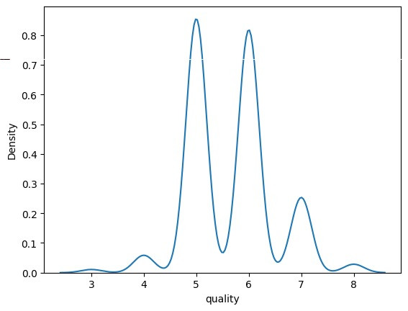
The graph you see is a KDE plot, which estimates the probability density function of the variable “quality.”
The x-axis represents different quality ratings (ranging from 3 to 8).
The y-axis represents the density (probability density) of each quality rating.
The KDE plot smooths out the distribution of quality scores, showing where most of the data points are concentrated.
There are three prominent peaks in the KDE plot:
Around quality score 4: Indicates a significant concentration of data points at this rating.
Around quality score 6: Another peak, suggesting a common quality rating.
Slightly above quality score 7: A smaller peak, indicating wines with higher quality.
The smooth blue curve represents the estimated density of quality ratings.
In summary, this visualization helps us understand the distribution of wine quality ratings based on the KDE estimation.

Slide 16
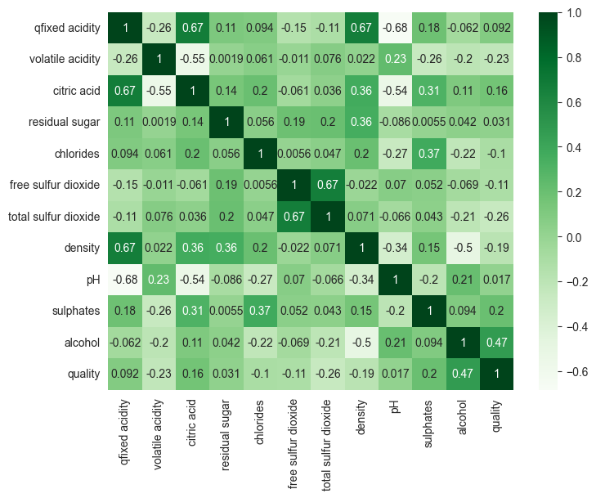

Slide 17
Heatmap of Correlations:
The graph you see is a heatmap representing the correlations between different attributes in the wine dataset.
Here’s what each component represents:
Attributes:
The heatmap displays various attributes (columns) from the Data Frame, including:
“fixed acidity”
“volatile acidity”
“citric acid”
“residual sugar”
“chlorides”
“free sulfur dioxide”
“total sulfur dioxide”
“density”
“pH”
“sulphates”
“alcohol”
“quality”
Color Coding:
The cells are colored differently:
Darker cells: Represent low correlation (values close to 0).
Lighter cells: Represent high correlation (values greater than 0.7, as specified in your code).
The diagonal line (from top-left to bottom-right) is always perfectly correlated (value 1) because it represents the correlation of an attribute with itself.
Annotations:
Each cell contains an annotation:
A ‘1’ indicates high positive correlation.
A ‘0’ indicates low or no significant correlation.
In summary, this heatmap helps us understand how different attributes relate to each other in the wine dataset.

Slide 18
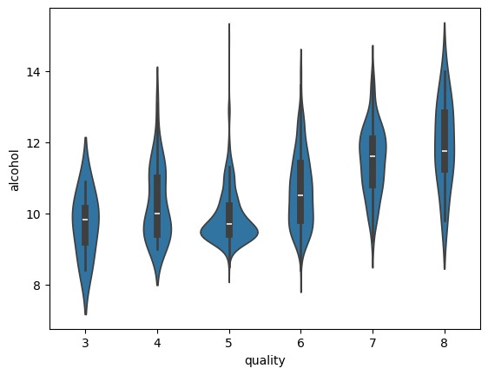
A violin plot is a combination of a box plot and a kernel density estimate (KDE) plot.
It provides insights into the distribution of a continuous variable (in this case, “alcohol”) across different categories (quality ratings).
Each violin shape represents the distribution of alcohol content for wines of a specific quality rating.
The wider sections of the violin indicate higher frequencies of wines with that particular alcohol content.
Inside each violin:
The black bar represents the interquartile range (IQR), showing where the middle 50% of data lies.
The white dot represents the median alcohol content.
In summary, this plot helps us understand how alcohol content varies across different wine quality ratings, combining information about central tendency and distribution.

Slide 19



Results and Analysis
Data Visualization
Statistical Analysis
Report Generation
Visual representations of the data to gain meaningful insights and trends.
Utilizing statistical methods to interpret the relationships between wine attributes and quality ratings.
Creating comprehensive reports to communicate the findings of the wine quality analysis.

Slide 20
Conclusion and Future Directions
3
5K
2M
Data-Driven Decisions
Enhanced Efficiency
Continual Innovation
Empowering wine producers with actionable insights for informed decision-making.
Improving production processes and distribution efficiency through advanced AI and ML techniques.
Paving the way for ongoing innovation in the wine industry through predictive analytics.

